Slide 1
CSF 3206
(SEM II 2020/21)
Chapter 5
Part I
Intro. to Javascript

Slide 2
What You Need to Know
HTML
Text editor
Web browsers
The different versions of JavaScript
Faizah Aplop CSF3107/2016

Slide 3
What You Will Learn
Component of Dynamic Website
Intro to JavaScript
Basic JavaScript
* Data type * Variable
* Constant * Operator
* Dialog Box * Looping
* Conditional * Function
Faizah Aplop CSF3107/2016

Slide 4
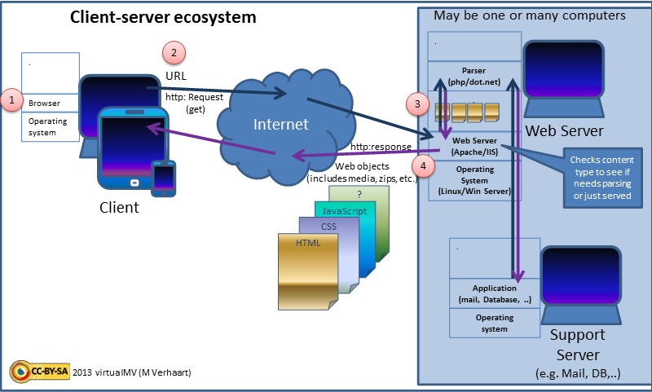
Source: Wikipedia

Slide 5
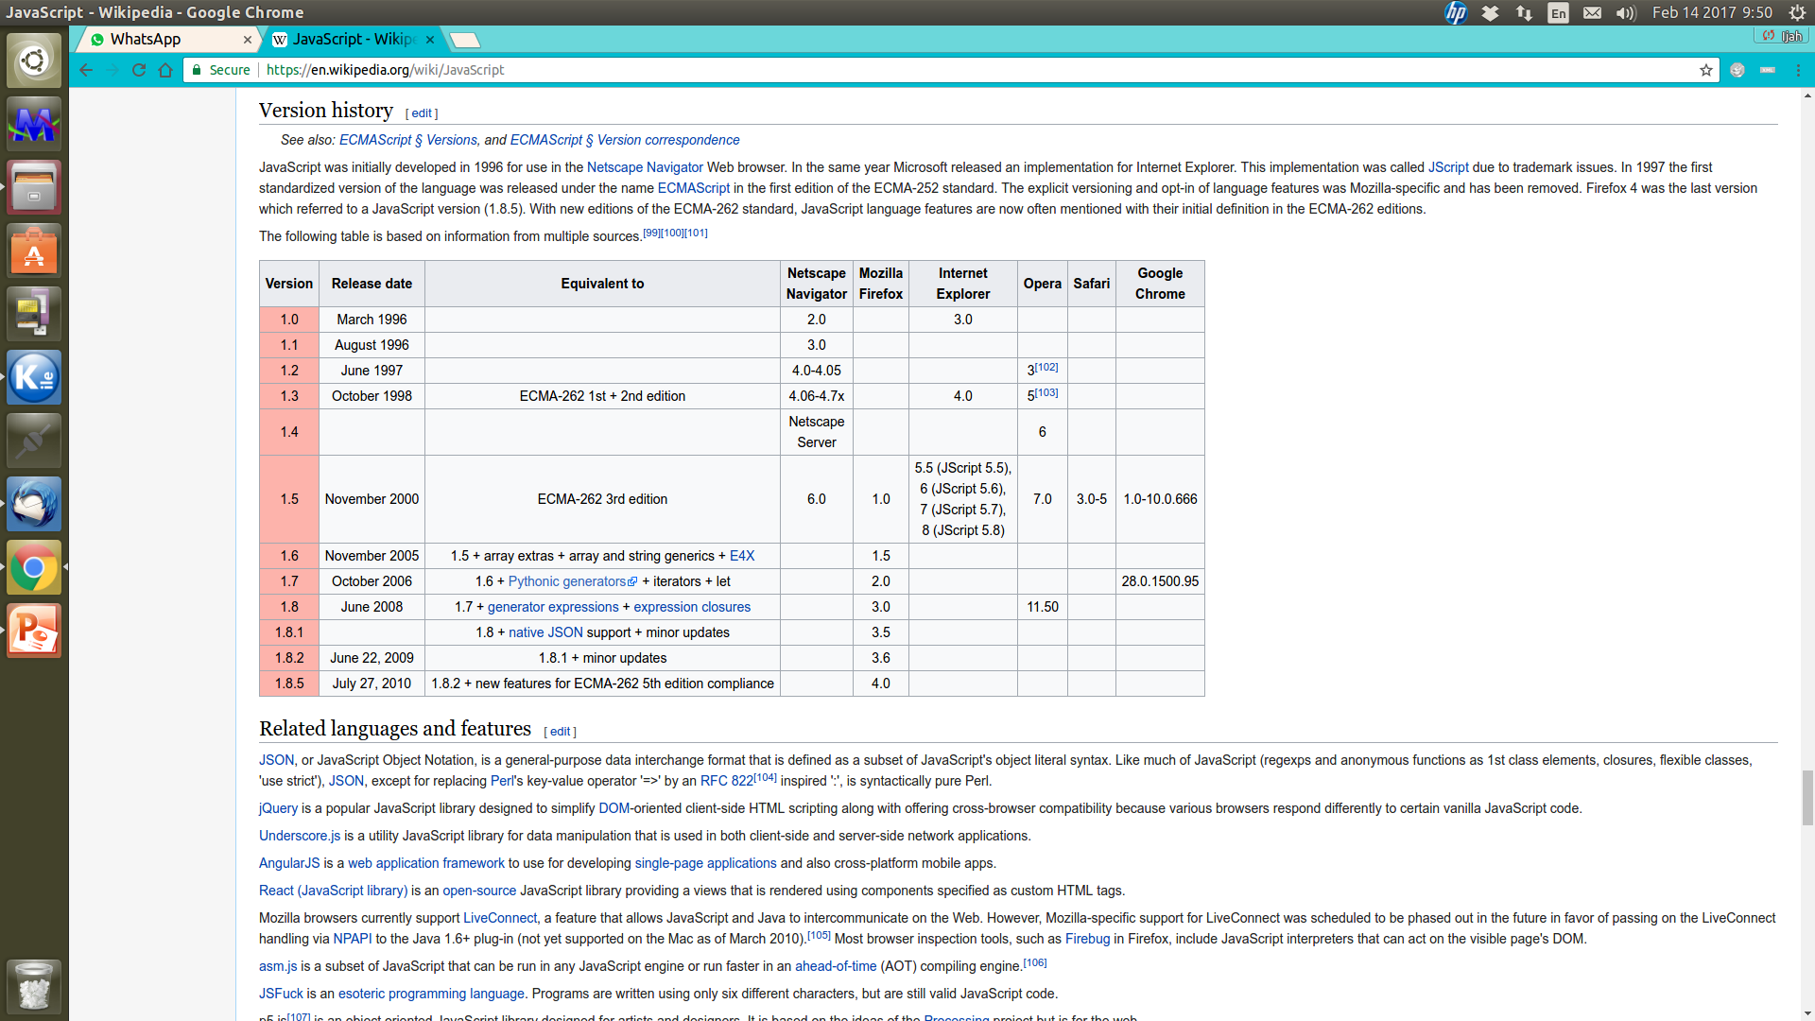
JavaScript History & Development
Source: Wikipedia
Faizah Aplop CSF3107/2016

Slide 6
Components of Dynamic Web site
SERVER
Server-side scripting
(e.g. JSP)
Database
(e.g. MySQL)
Marked-up content
(HTML,XHTML,XML)
Style sheets
(CSS)
Client-side scripting
(e.g. JavaScript)
Images & Objects
(e.g. JPEG, Flash)
User Agent
(e.g. Browsers)
User
Faizah Aplop CSF3107/2016
Source: Goodman et.al (2010), Javascript Bible - 7th Edition

Slide 7
An Introduction
JavaScript is a scripting language designed primarily for adding interactivity to Web pages and creating Web applications.
JavaScript is a programming language used to make web pages interactive. -> allowing a page to interact with users and respond to events that occur on the page.
JavaScript is different from the Java language BUT can interoperate well.
Client-side JavaScript programs, or scripts, can be embedded directly in HTML source of Web pages OR can be created as standalone program (extension with .js) and developer invoke it via browser/HTML.
©MohamadNor 2015
CSF3107

Slide 8
JavaScript versus HTML
- HTML is a markup language designed for defining static web page content.
-> Case-insensitive
- JavaScript is a programming language designed for performing dynamic tasks.
-> Case-sensitive
In syntax, JavaScript is similar to C.
JavaScript is associated with a browser, it is tightly integrated with HTML.
JavaScript programs are executed by a JavaScript interpreter built in the browser.
©MohamadNor 2015
CSF3107

Slide 9
The Right Tool for the Right Job ....
No | Can Do | Cannot Do
1 | Web page to respond to user interaction with form elements (e.g. buttons, text, checkboxes, lists) & hypertext links | Set or retrieve the browser's preferences settings, main window appearance features, action buttons and printing capability
2 | Distribute small collections of db-like info & provide a friendly interface data | Launch an application on the client computer
3 | Control multiple-frame navigation, plug-ins, or java applets based on user choices in the html docs | Read or write files or directories on the client computer (except 'cookies')
4 | Preprocessing data on the client before submission to a server | Write directly to files on the server
5 | Changing content & styles in modern browsers dynamically & instantly | Capture live data streams from the server for retransmission
6 | Requesting files from the server, & making read & write requests of server-side scripts | Send secret emails from web site visitors to you
Faizah Aplop CSF3107/2016

Slide 10
Object
Based
Can use objects
Not class based
Client
Side
Runs in client (s/w) – the web browser
JavaScript
Client-side
Language
The browser reads & interprets the codes w/o info from server
Allow info to be validated before sending to server-side
Scripting
Language
Does not require a program to be compiled
On the fly interpretation by client
Faizah Aplop CSF3107/2016

Slide 11
The Common Layout of HTML Page
Contains the content & structure of
web page
HTML
Controls the appearance & presentation
of the web page
CSS
Controls the behaviour of the web page
JS
©MohamadNor 2015
CSF3107

Slide 12
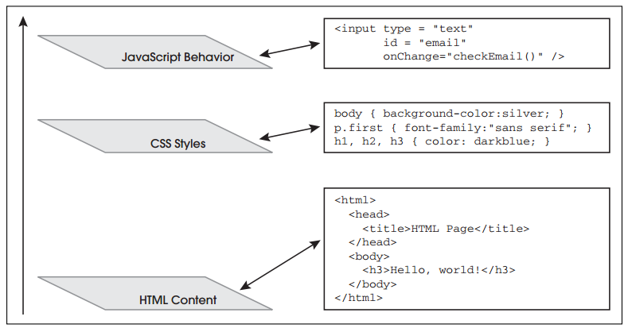
Three Layers Making Up a Web Page
Source: Ellie Quigley (2011), JavaScript by Example – 2nd Editions.
©MohamadNor 2015
CSF3107

Slide 13
How JavaScript Work?
Server
Browser request page index.html
Page index.html Loading
1. HTML code is read and rendered line by line until a JavaScript opening tag is read.
2. A sequence JavaScript code is interpreted by JavaScript interpreter until closing JavaScript tag is reached.
2. The portion of HTML code is continued read and rendered.
©MohamadNor 2015
CSF3107

Slide 14
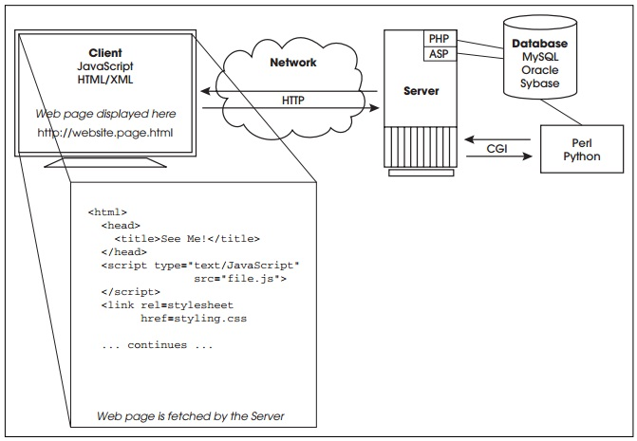
The Life Cycle of Typical Web Page
Source: Ellie Quigley (2011), JavaScript by Example – 2nd Editions.
©MohamadNor 2015
CSF3107

Slide 15
Javascript Engine
Rhino - managed by the Mozilla Foundation, open source, developed entirely in Java
SpiderMonkey - the first JavaScript engine, which powered Netscape Navigator and today powers Firefox
V8 - open source, developed by Google in Denmark, part of Google Chrome
JavaScriptCore - open source, marketed as Nitro and developed by Apple for Safari
KJS - KDE's ECMAScript/JavaScript engine originally developed by Harri Porten for the KDE project's Konqueror web browser
Chakra (JScript9) - for Internet Explorer
Chakra (JavaScript) - for Microsoft Edge
Nashorn - open source as part of OpenJDK, written by Oracle Java Languages and Tool Group
Source: Wikipedia
Faizah Aplop CSF3107/2016

Slide 16
Javascript Editors & IDE
ActiveState's Komodo IDE
Eclipse with JSDT
Microsoft's Visual Studio 2013
NetBeans
Sublime Text
JetBrains' WebStorm
Alpha Anywhere
Komodo Edit
Notepad++
TextMate
Gedit
Faizah Aplop CSF3107/2016

Slide 17
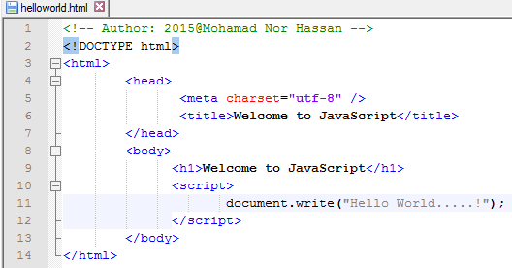
The First JavaScript Program
JavaScript
©MohamadNor 2015
CSF3107
Notes:
‹#›

Slide 18
<HTML>
<BODY>
<SCRIPT language =”JavaScript”>
Document.write(“Hello JavaScript coder!”);
</SCRIPT>
</BODY>
</HTML>
Faizah Aplop CSF3107/2016

Slide 19
<HTML>
<BODY>
<SCRIPT language =”JavaScript1.2”>
<!--
JavaScript code here
//-->
</SCRIPT>
</BODY>
</HTML>
Faizah Aplop CSF3107/2016

Slide 20
DATA TYPES
&
STRING LITERALS

Slide 21
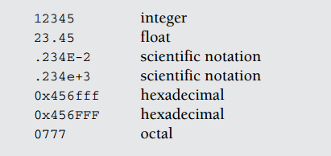
Data Types
Primitive Data Types
    Numeric -> integer & floating numbers
    string
    Boolean
Two special data types
    null
    undefined
Source: Quigley, E. (2012) ,JavaScript by Example.- 2nd Edition.
©MohamadNor 2015
CSF3107

Slide 22
String Literals and Quoting
String literals – rows of characters enclosed in either double or single quotes.
The quotes must be matched.
Examples;
  “This is Kuala Terengganu”
  ‘This is another Kuala Terengganu’
  “This is also ‘Kuala Terengganu’ ”
  ‘This is “Kuala Terengganu” ’
Empty set of quotes is called null string.
If number enclosed in quotes, is consider a string. E.g. “8”, whereas 8 is number.
©MohamadNor 2015
CSF3107
‹#›

Slide 23
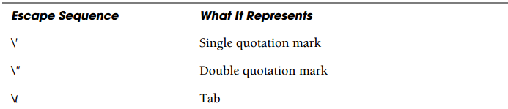
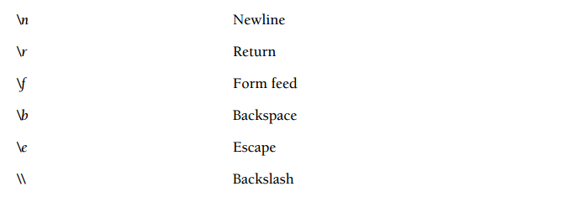
Escape Sequences
String can contains escape sequences (a single characters preceded with backslash).
Source: Quigley, E. (2012), JavaScript by Example – 2nd Edition.
©MohamadNor 2015
CSF3107

Slide 24
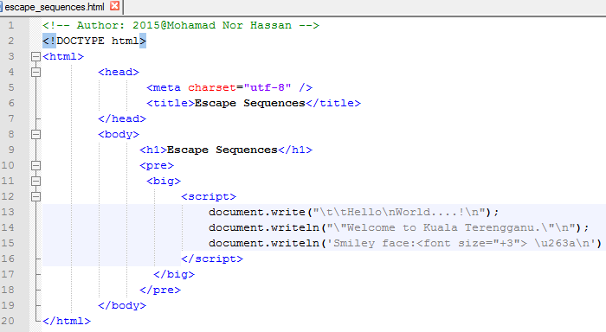
Example Escape Sequences
Line 1
Line 2
Line 3
Line 4
Line 5
©MohamadNor 2015
CSF3107

Slide 25
Line 1 – escape sequences ONLY work If in a <pre> tag or an alert dialog box.
Line 2 - JavaScript program start here.
Line 3 – The write() methods send to browser a string containing 2 tabs (\t\t), Hello a newline (\n) World…..!, and another newline (\n).
Line 4 – The writeln() methods send to browser a string containing a double quote (\”), Welcome to Kuala Terengganu, another double quote (\”), and a newline (\n).
Line 5 – The string contains a backslash sequence that will be translated into Unicode hexadecimal character 263a is preceded by a \u.
©MohamadNor 2015
CSF3107

Slide 26
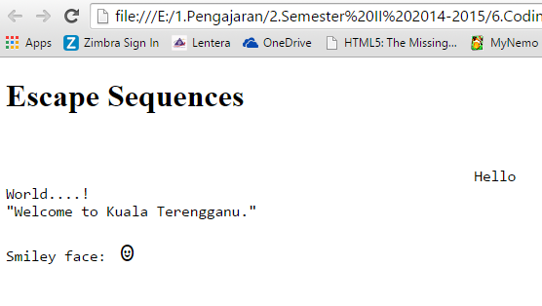
Output for Escape Sequences
©MohamadNor 2015
CSF3107

Slide 27
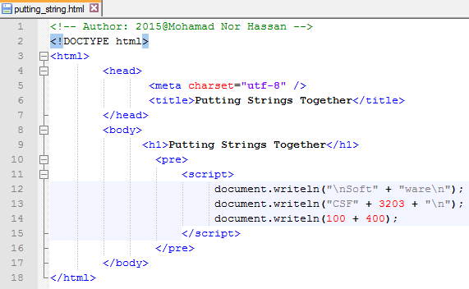
Putting String Together
©MohamadNor 2015
CSF3107

Slide 28
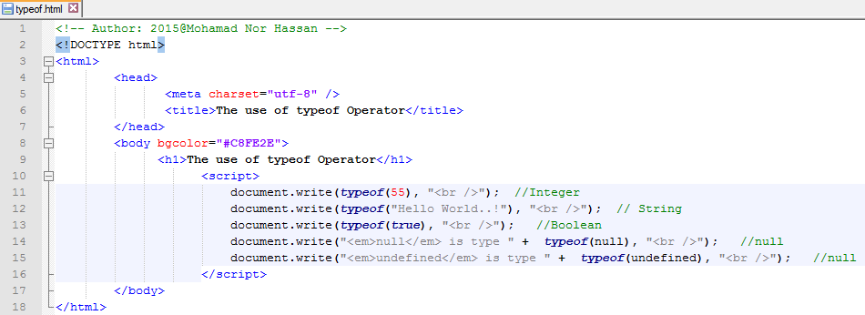
typeof Operator
Return a string to identify the type of its operand (i.e., a variable, string, keyword or object).
©MohamadNor 2015
CSF3107

Slide 29
Variables

Slide 30
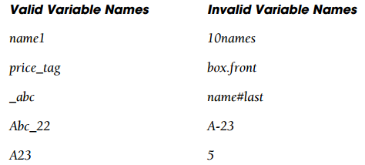
var num1;
var town;
var x1
num1 = 8;
town = “Kuala Terengganu”
x1 = 5.46
Source: Quigley, E. (2012), JavaScript by Example- 2Nd Edition.
©MohamadNor 2015
CSF3107

Slide 31
Example 1:
var length = 16; // Number
var lastName = "Johnson"; // String
var cars = ["Saab", "Volvo", "BMW"]; // Array
var x = {firstName:"John", lastName:"Doe"};// Object
var x = “ ”; // Null
var x = true; // Booleans
var y = false;
Example 2:
var x; // x is undefined
var x = 5; // Now x is a Number
var x = "John"; // Now x is a String
Faizah Aplop CSF3107/2016

Slide 32
Example 3:
typeof undefined
typeof null
null == undefined
null === undefined
var car = "";
var person = undefined;
// undefined
// object
// true
// false
// Value is "", the typeof is string
// Value is undefined, type is undefined
Faizah Aplop CSF3107/2016

Slide 33
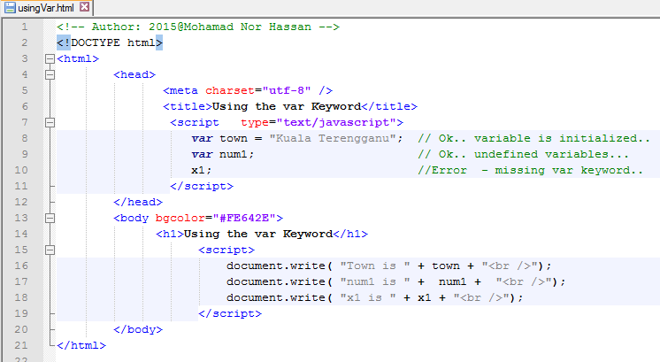
Declaring and Displaying Variables
©MohamadNor 2015
CSF3107

Slide 34
CONSTANT

Slide 35
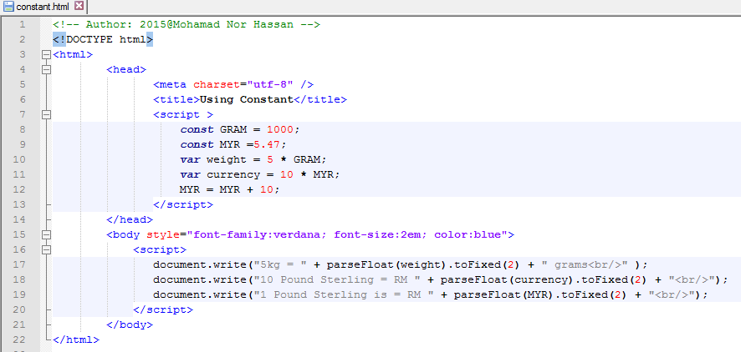
The value cannot be changed during program execution.
Syntax – const variableName;
CSF3107-2016@Mohamad Nor Hassan
‹#›

Slide 36
DIALOG BOX

Slide 37
Purpose of Dialog Box – to interact with user.
alert()
prompt()
confirm()
CSF3107-2016@Mohamad Nor Hassan
‹#›

Slide 38
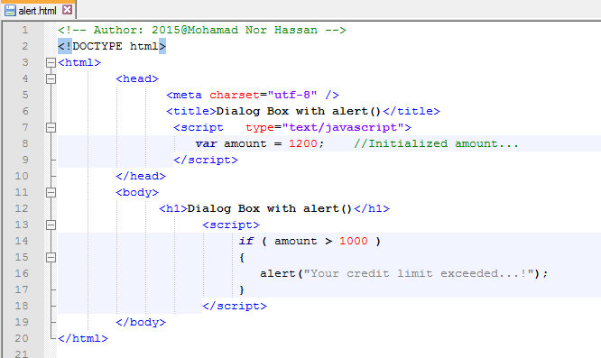
alert()
Purpose – to send a warning /alert to the user to do something.
CSF3107-2016@Mohamad Nor Hassan
‹#›

Slide 39
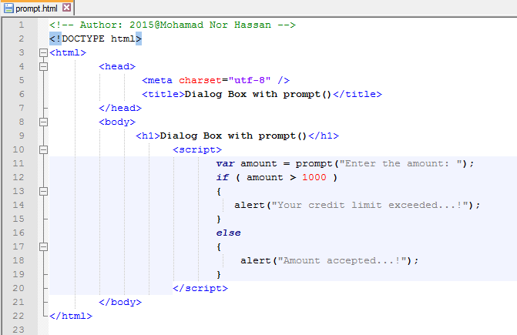
prompt()
Purpose – ask users to key-in/fill-up the form input for certain information
CSF3107-2016@Mohamad Nor Hassan
‹#›

Slide 40
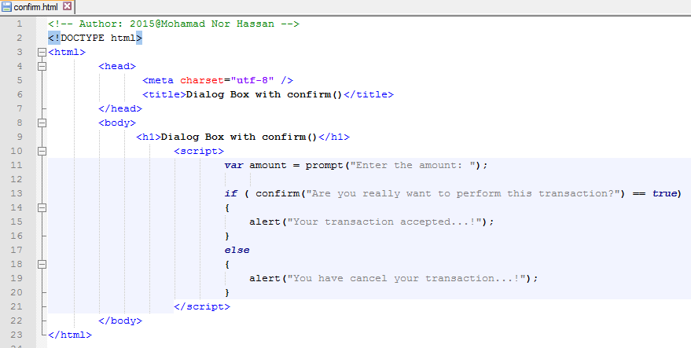
confirm()
Purpose – used to confirm a user’s answer to question.
CSF3107-2016@Mohamad Nor Hassan
‹#›

Slide 41
OPERATOR

Slide 42
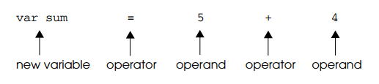
Similar with other programming.
Operands – an operator manipulates data objects.
Operators and operands are found in expressions.
Source: Quigley, E. (2012) – JavaScript by Example. Second Edition.
CSF3107-2016@Mohamad Nor Hassan
‹#›

Slide 43
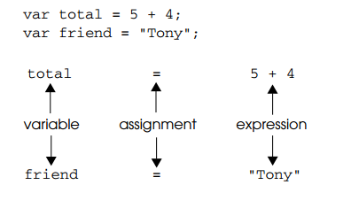
Assignment Statement
Evaluates the expression on the RHS of equal sign and assign the result to variable on LHS of = sign.
Source: Quigley, E. (2012) – JavaScript by Example. Second Edition.
CSF3107-2016@Mohamad Nor Hassan
‹#›

Slide 44
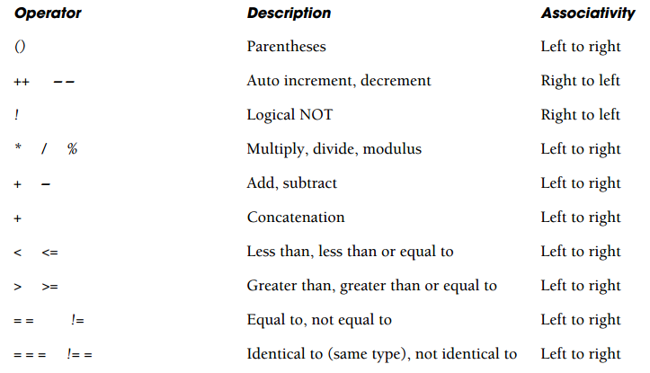
JavaScript Operator
Source: Quigley, E. (2012) – JavaScript by Example. Second Edition.
CSF3107-2016@Mohamad Nor Hassan
‹#›

Slide 45
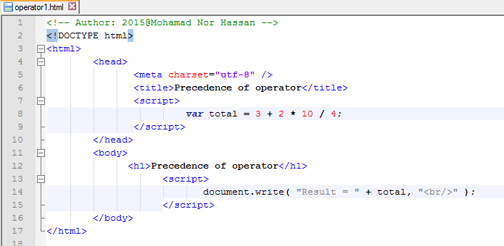
Example 1 - Using operator
CSF3107-2016@Mohamad Nor Hassan
‹#›

Slide 46
Arithmetic Operator
x + y -> Addition
x – y -> Subtraction
x * y -> Multiplication
x / y -> Division
x % y -> Modulus
CSF3107-2016@Mohamad Nor Hassan
‹#›

Slide 47
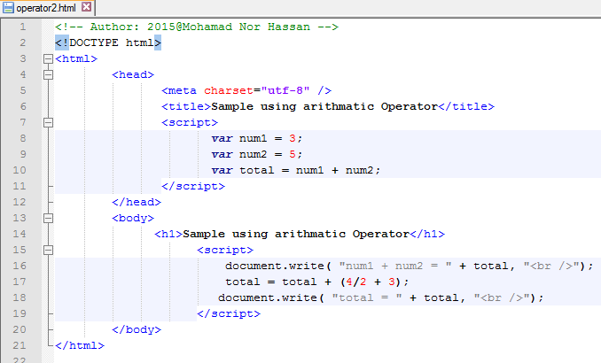
Example of Arithmetic Operator
CSF3107-2016@Mohamad Nor Hassan
‹#›
Notes:
‹#›

Slide 48
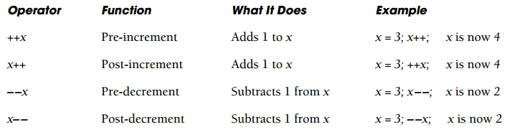
Autoincrement and Autodecrement Operators
Source: Quigley, E. (2012) – JavaScript by Example. Second Edition.
CSF3107-2016@Mohamad Nor Hassan
‹#›
Notes:
‹#›

Slide 49
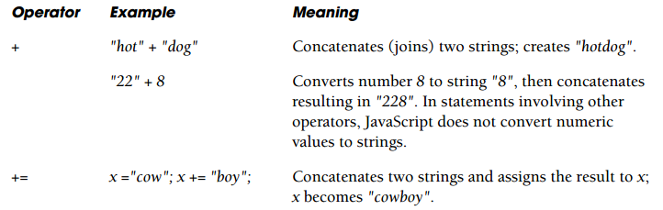
Concatenation Operators
Source: Quigley, E. (2012) – JavaScript by Example. Second Edition.
CSF3107-2016@Mohamad Nor Hassan
‹#›
Notes:
‹#›

Slide 50
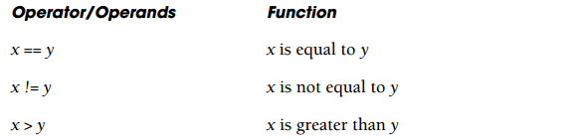
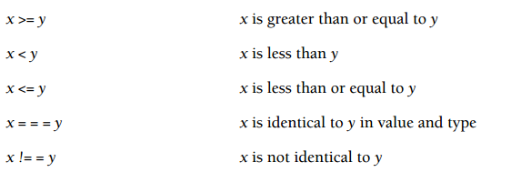
Comparison Operators
Source: Quigley, E. (2012) – JavaScript by Example. Second Edition.
CSF3107-2016@Mohamad Nor Hassan
‹#›
Notes:
‹#›

Slide 51
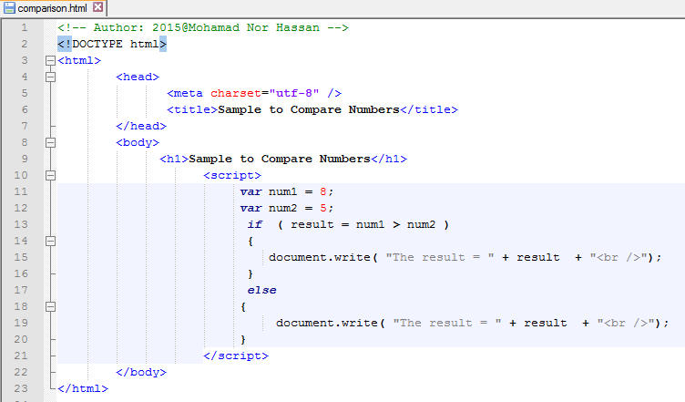
Example of Comparison Operators
CSF3107-2016@Mohamad Nor Hassan
‹#›
Notes:
‹#›

Slide 52
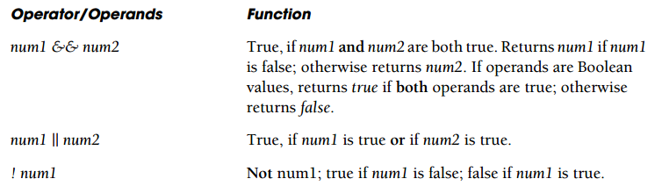
Logical Operators
Source: Quigley, E. (2012) – JavaScript by Example. Second Edition.
CSF3107-2016@Mohamad Nor Hassan
‹#›
Notes:
‹#›

Slide 53
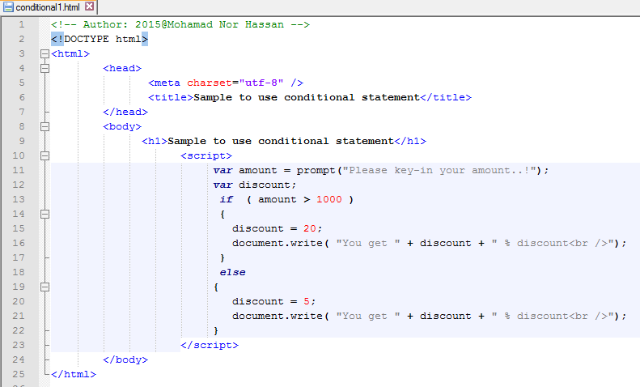
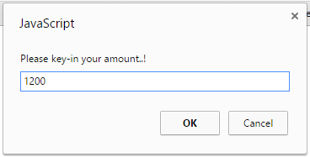
Conditional Operators – Option 1
if ( c1 )
{
stat_1;
}
else if ( c2 )
{
stat_2;
}
else
{
stat_3;
}
CSF3107-2016@Mohamad Nor Hassan
‹#›
Notes:
‹#›

Slide 54
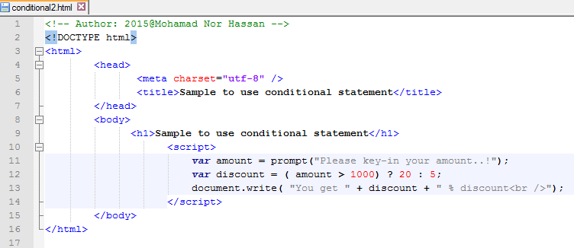
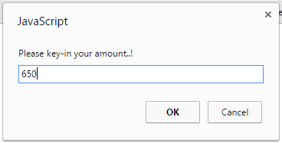
Conditional Operators – Option 2
CSF3107-2016@Mohamad Nor Hassan
‹#›
Notes:
‹#›

Slide 55
DATA TYPE CONVERSION

Slide 56
Data Type Conversion
JavaScript provides 3 functions to convert the primitive data types;
  String()
  Number()
  Boolean()
parseInt(String, NumberBase) – convert a string into a number
parseFloat() – convert to floating-point number.
eval() – evaluates a string as a JavaScript expression.
- The argument of the eval() function is a string.
- If the string represents an expression, eval() evaluates the
expression.
CSF3107-2016@Mohamad Nor Hassan
‹#›

Slide 57
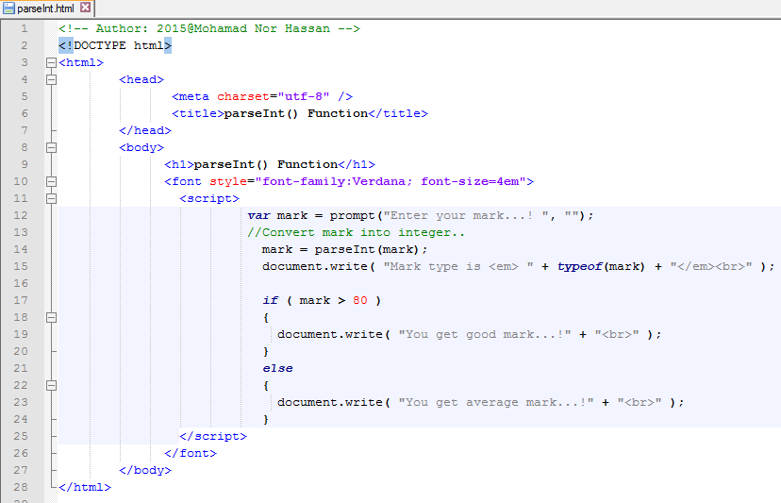
Using parseInt() Function
parseInt()
CSF3107-2016@Mohamad Nor Hassan
‹#›

Slide 58
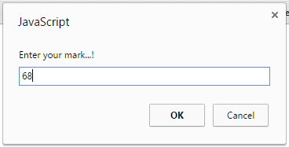
Output Using parseInt() Function
CSF3107-2016@Mohamad Nor Hassan
‹#›

Slide 59
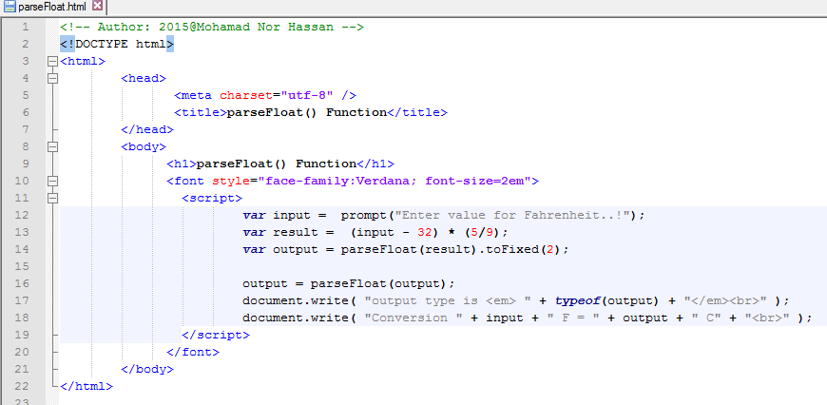
Using parseFloat() Function
parseFloat()
CSF3107-2016@Mohamad Nor Hassan
‹#›

Slide 60
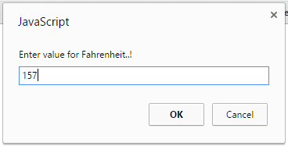
Output Using parseFloat() Function
CSF3107-2016@Mohamad Nor Hassan
‹#›

Slide 61
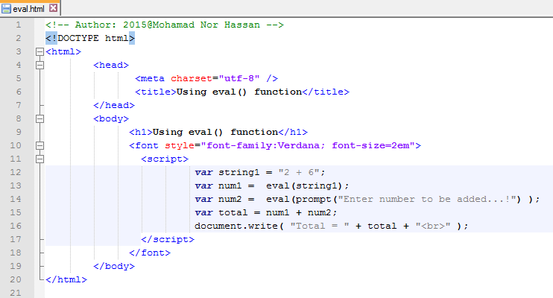
Using eval() Function
eval()
CSF3107-2016@Mohamad Nor Hassan
‹#›

Slide 62
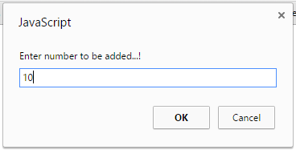
Output Using eval() Function
CSF3107-2016@Mohamad Nor Hassan
‹#›

Slide 63
LOOPING

Slide 64
while
for
do/while
CSF3107-2016@Mohamad Nor Hassan
‹#›

Slide 65
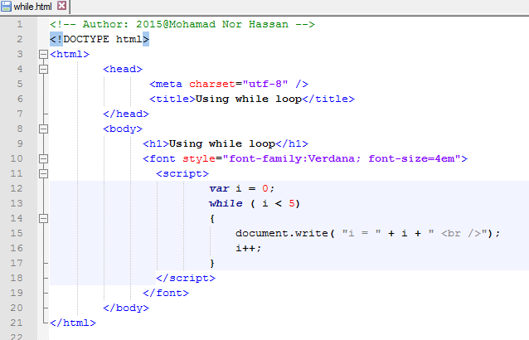
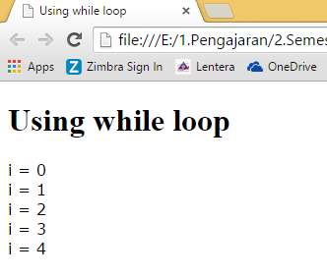
while Looping
CSF3107-2016@Mohamad Nor Hassan
‹#›

Slide 66
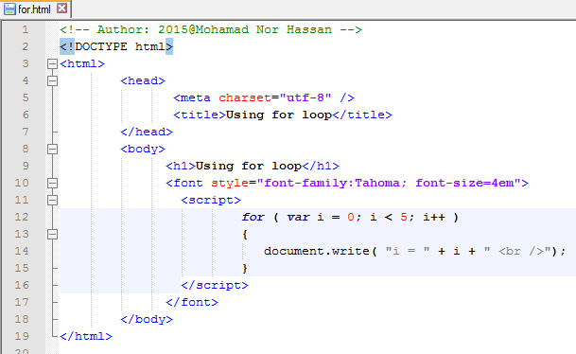
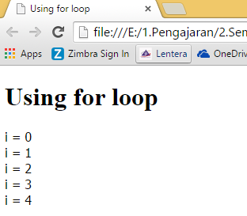
for Looping
CSF3107-2016@Mohamad Nor Hassan
‹#›

Slide 67
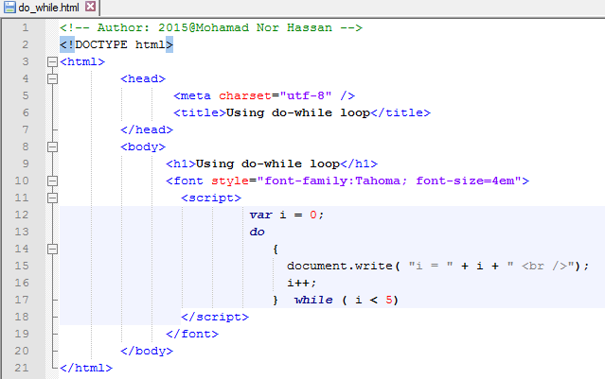
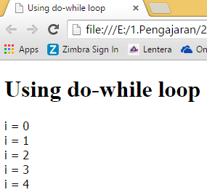
do/while Looping
CSF3107-2016@Mohamad Nor Hassan
‹#›

Slide 68
FUNCTIONS

Slide 69
Functions
Self-contained units of program to accomplish specific tasks.
Definition – a block of statements that not only executes some task, but also return a value (return output).
Known as “black box”
E.g.; calculate car loan, temperature conversion, etc.
It is can be reused again and again.
function
Program Logic
Output
(assigned to variable)
Input
Return Value
CSF3107-2016@Mohamad Nor Hassan
‹#›

Slide 70
Functions Definition & Function Call
Function Definition
function function_name (param1, param2)
{
statement1;
statement2;
return value; [optional]
}
Function Call
var output1 = function_name (param1, param2);
CSF3107-2016@Mohamad Nor Hassan
‹#›

Slide 71
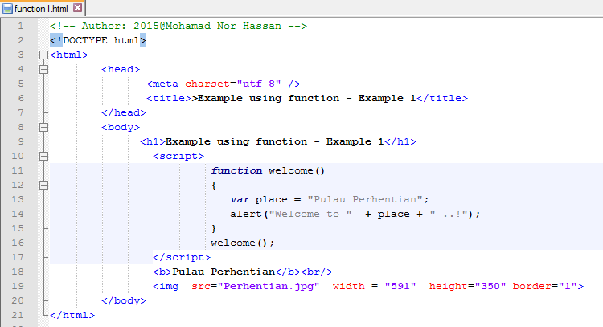
Simple Function
CSF3107-2016@Mohamad Nor Hassan
‹#›

Slide 72
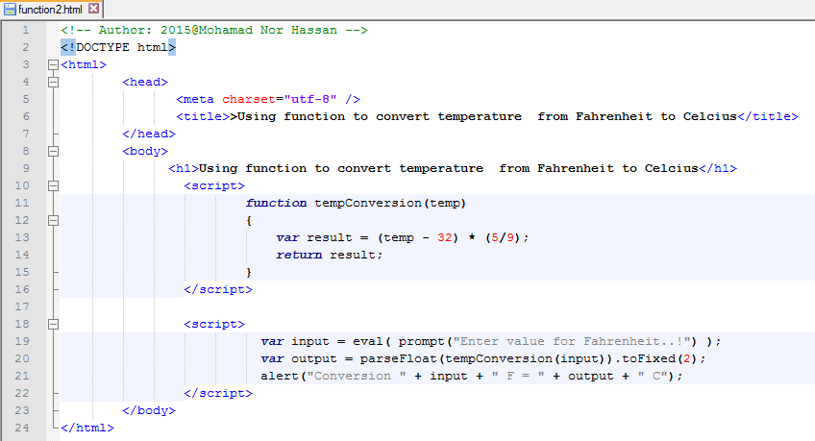
Function With Parameter
CSF3107-2016@Mohamad Nor Hassan
‹#›
Notes:
‹#›

Slide 73
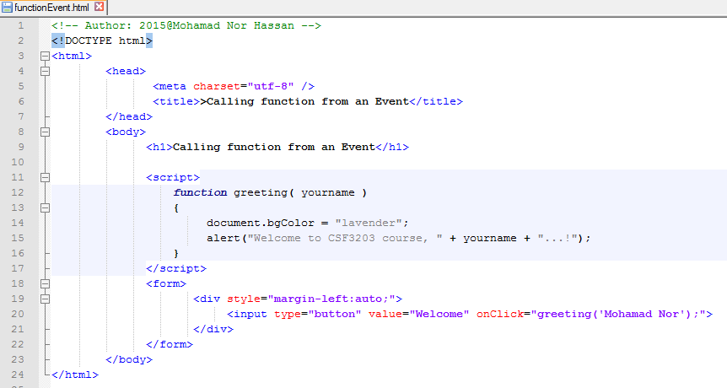
Calling a Function From an Event
An event
CSF3107-2016@Mohamad Nor Hassan
‹#›
Notes:
‹#›

Slide 74
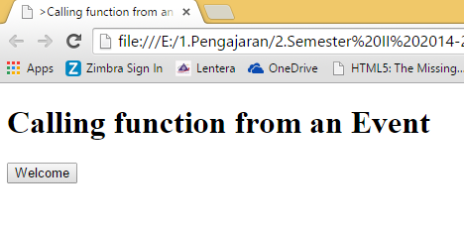
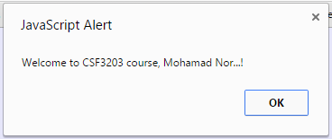
Output Calling a Function From an Event
Step 1
When click the button
CSF3107-2016@Mohamad Nor Hassan
‹#›

Slide 75

Calling a Function From a Link
A link
CSF3107-2016@Mohamad Nor Hassan
‹#›
Notes:
‹#›

Slide 76


Output Calling a Function From a Link
Step 1
When click the button
CSF3107-2016@Mohamad Nor Hassan
‹#›

Slide 77
Reference
Quigley, E. (2012). JavaScript by Example. 2nd Edition. Michigan, USA. Prentice Hall.
Negrino, T. & Smith, D.(2012) – JavaScript Eight Edition. Berkeley, CA. Visual QuickStart Guide.
W3schools.com (2014). JavaScript Tutorial. http://www.w3schools.com/js/default.asp
Tutorialspoint – Simply Easy Learning (2014). Javascript Tutorial. http://www.tutorialspoint.com/javascript/index.htm
CSF3107-2016@Mohamad Nor Hassan
‹#›

